Slide 1


DIVYA ARVIND PAWAR
21/09/2025

Slide 2

Outline
Executive Summary
Introduction
Methodology
Results
Conclusion
Appendix

Slide 3
Executive Summary
Summary of methodologies
Summary of all results
- Collected launch data using SpaceX API and static JSON files
- Cleaned and filtered data for single-core, single-payload launches post-2010
- Performed EDA using Pandas, Matplotlib, Seaborn, and SQL queries
- Built interactive visualizations with Folium and Plotly Dash
Applied classification models to predict Falcon 9 landing success
- Identified key features influencing landing success: payload mass, booster version, launch site
- Achieved [insert your model accuracy here] accuracy using [model name]
- Created an interactive dashboard for launch insights
- Mapped launch sites and outcomes using Folium
- Extracted SQL-based insights on launch frequency and success rates

Slide 4
Introduction
Project background and context
Problems you want to find answers
- SpaceX revolutionized space travel by reusing rocket boosters, drastically reducing launch costs.
- Predicting whether a Falcon 9 booster will land successfully is crucial for cost estimation and mission planning.
- This project uses real launch data to build a predictive model for booster landing success.
- Can we build a reliable classification model to predict landing outcomes?
- How do launch site, payload mass, booster version, and other features correlate with success?
- What factors influence the success of a Falcon 9 booster landing?

Slide 5

Section 1

Slide 6
Methodology
Executive Summary
Data collection methodology:
Perform data wrangling
Perform exploratory data analysis (EDA) using visualization and SQL
- Used SpaceX API (requests.post and requests.get) to retrieve launch data
- Supplemented with static JSON and CSV files for consistent results
- Extracted nested fields like cores, payloads, and launchpad using ID-based API call
- Filtered launches to include datetime and extracted only single-core and single-payload missions
- Converted date_utc to launch date
- Mapped landing outcomes to binary classification labels (success = 1, failure = 0, unknown = 2)
- Used pandas, matplotlib, and seaborn for visual EDA
- Performed SQL queries to analyze launch frequency, success rates, and payload trends

Slide 7
Perform interactive visual analytics using Folium and Plotly Dash
- Created geospatial maps using Folium to visualize launch sites and outcomes
- Built a Plotly Dash dashboard for dynamic filtering and chartin
Perform predictive analysis using classification models
- Built classification models (e.g., Logistic Regression, Random Forest)
- Tuned hyperparameters and evaluated using accuracy, precision, recall
- Identified key features influencing landing succes
7

Slide 8
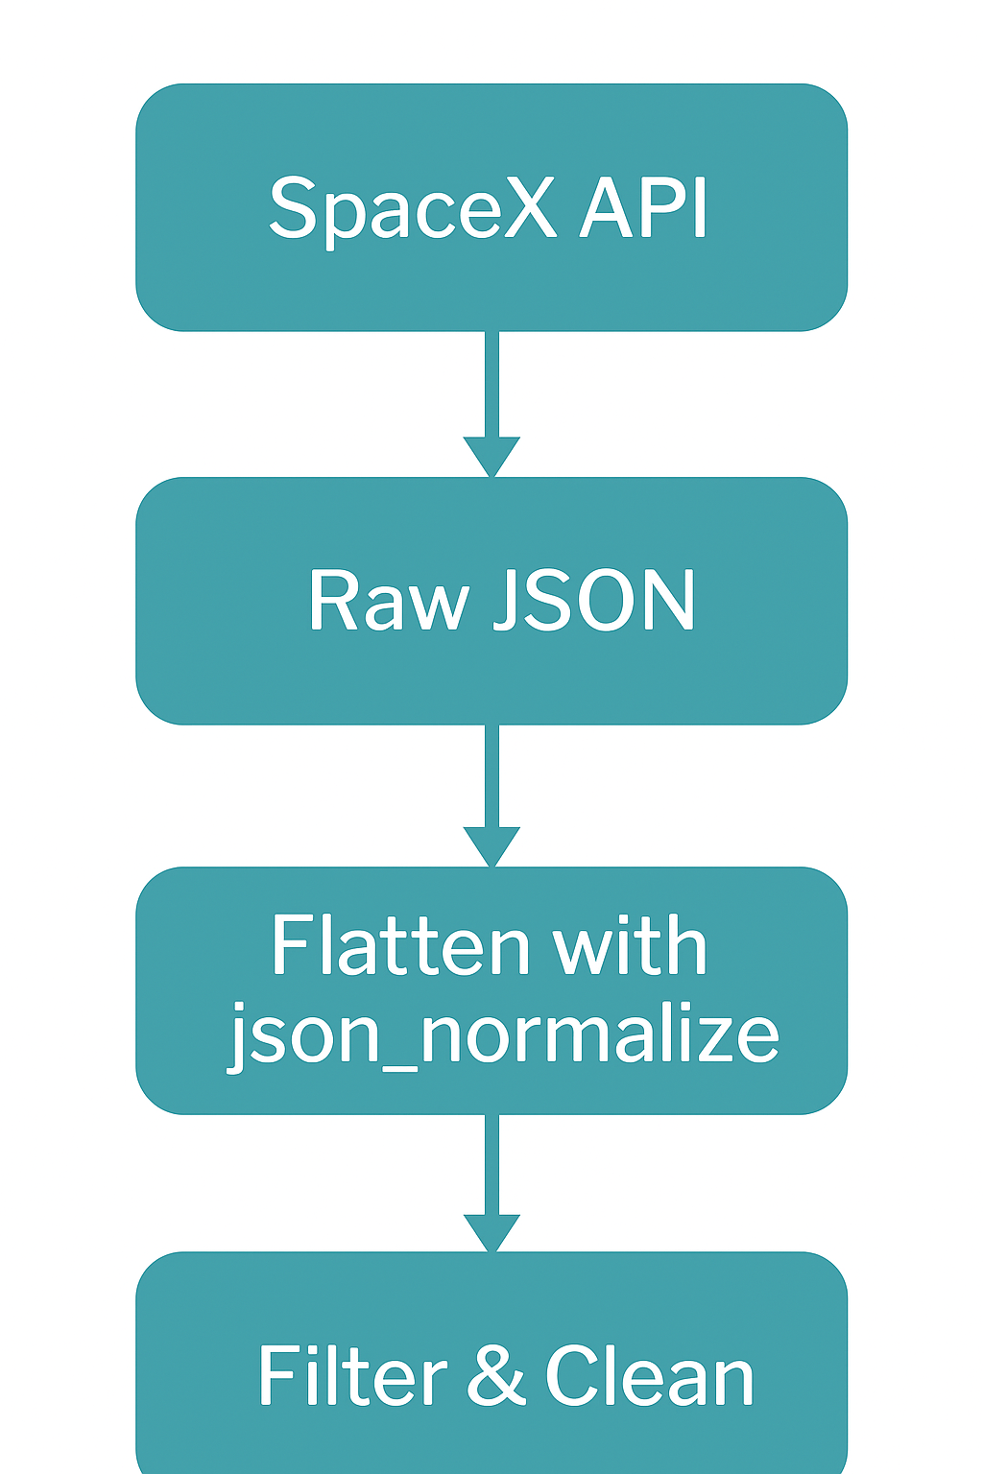
Data Collection
Describe how data sets were collected.
- Primary source: SpaceX API (v4/launches, v4/payloads, v4/cores, v4/launchpads)
- Supplementary sources:
Static JSON file for consistent results
CSV file (dataset_part_1.csv) for enriched metadata
- Used requests and json_normalize to parse nested JSON structures
You need to present your data collection process use key phrases and flowcharts
- RESTful API integration
- Nested data extraction
- ID-based enrichment
- Data consistency via static snapshot
- Filtering for single-core, single-payload launches

Slide 9
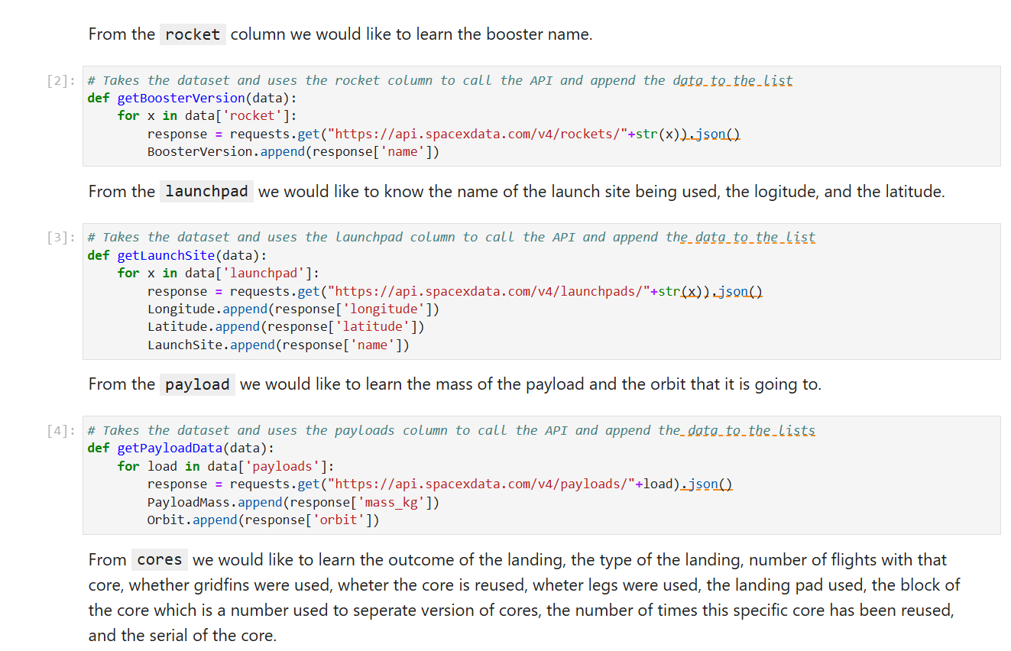
Data Collection – SpaceX API
To collect launch data, I integrated SpaceX’s RESTful API using Python’s requests library. I performed dynamic endpoint calls to retrieve nested JSON data from key resources such as rockets, launchpads, payloads, and cores. Each launch record was enriched by parsing these nested structures and extracting relevant metadata like booster version, payload mass, orbit type, and launch site coordinates. The raw JSON was flattened using json_normalize, and the dataset was filtered to include only single-core, single-payload missions for consistency. This process ensured a clean, structured DataFrame ready for analysis and modeling.
Add the GitHub URL of the completed SpaceX API calls notebook
Applied-Data-Science-Capstone/Data Collection API (1).ipynb at main · divp112005-coder/Applied-Data-Science-Capstone

Slide 10
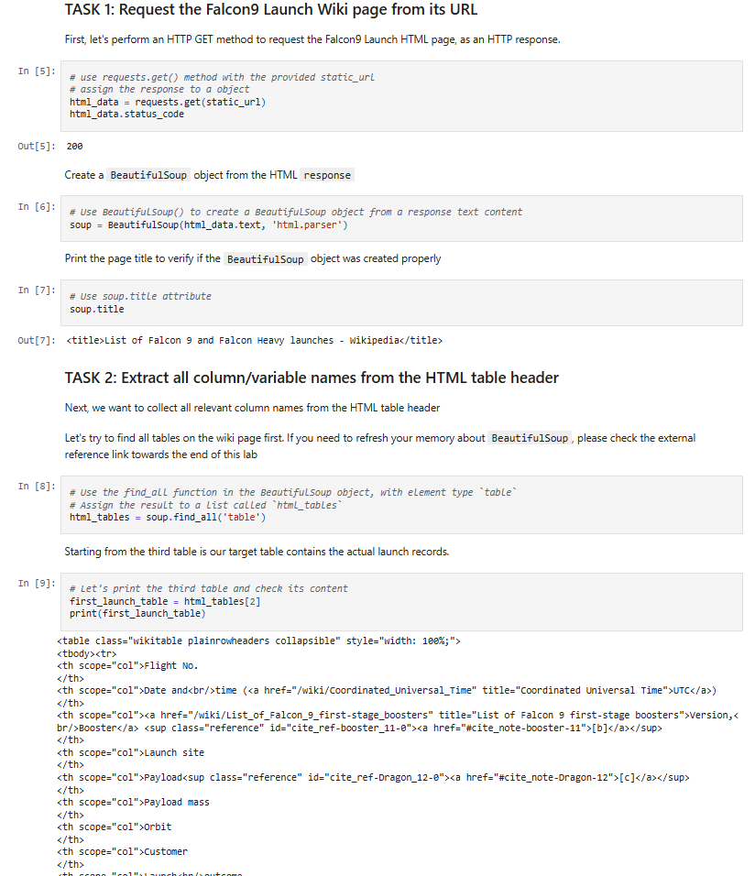
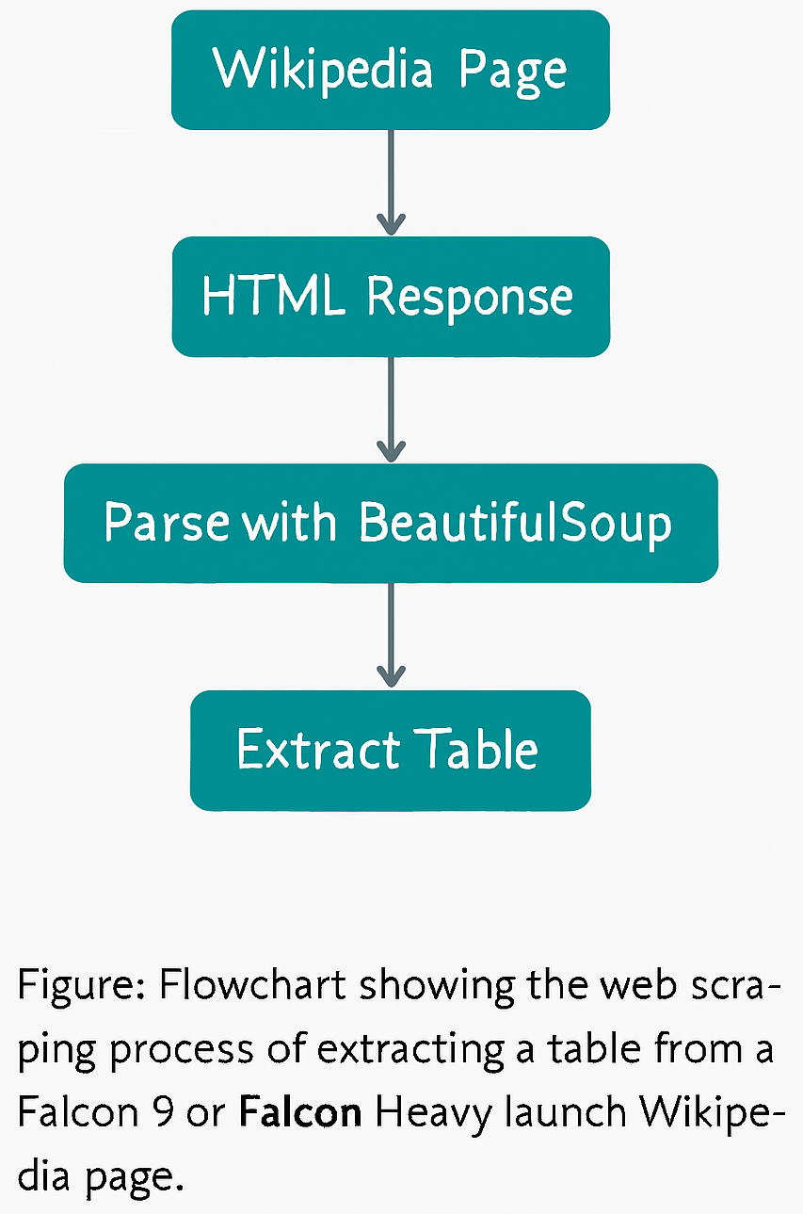
Data Collection - Scraping
To supplement the SpaceX API data, I performed web scraping using Python’s requests and BeautifulSoup libraries. I extracted Falcon 9 launch details from Wikipedia, including launch dates, payload mass, and orbit type. The scraped data was cleaned and merged with API results to create a more complete dataset. This process ensured consistency and filled gaps in the API records
GitHub URL of the completed web scraping notebook
Place your flowchart of web scraping here
Applied-Data-Science-Capstone/Data Collection with Web Scraping (1).ipynb at main · divp112005-coder/Applied-Data-Science-Capstone

Slide 11
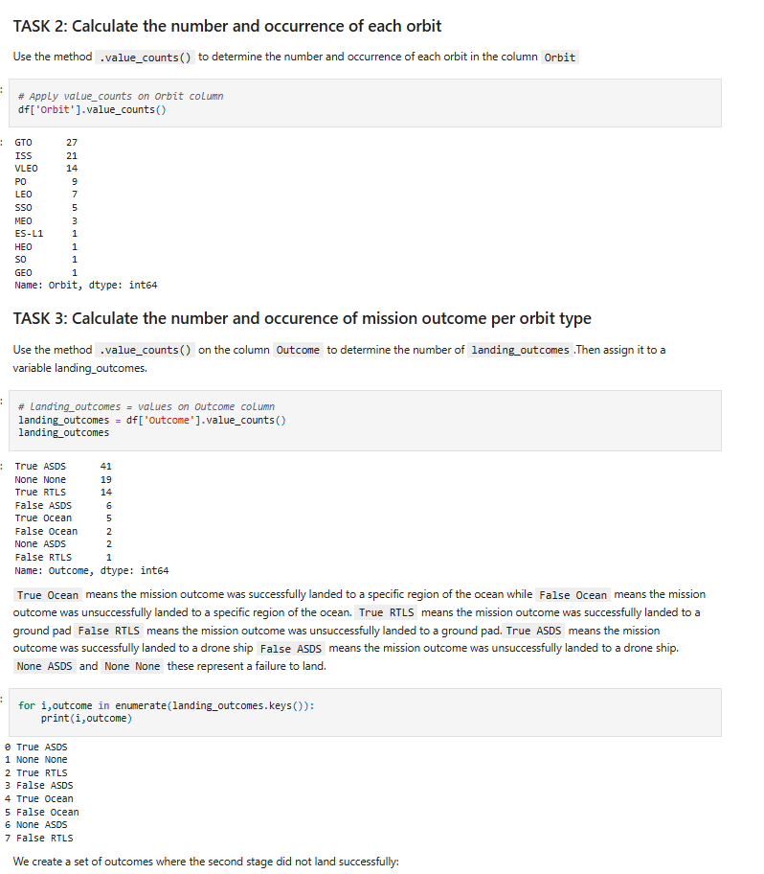
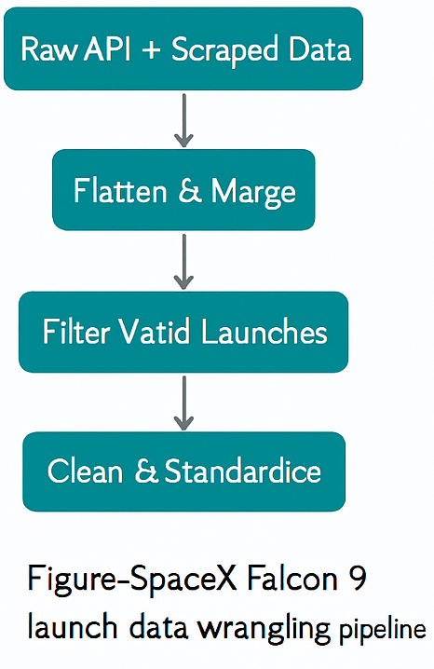
Data Wrangling
In the data wrangling phase, I combined launch records from the SpaceX API and Wikipedia scraping. I flattened nested JSON structures using json_normalize, handled missing values with conditional imputation, and standardized formats across columns. I filtered the dataset to include only single-core, single-payload launches, removed duplicates, and merged relevant metadata fields. These transformations ensured a clean, analysis-ready DataFrame for modeling and visualization.
GitHub URL of data wrangling
Applied-Data-Science-Capstone/Data Wrangling (1).ipynb at main · divp112005-coder/Applied-Data-Science-Capstone

Slide 12
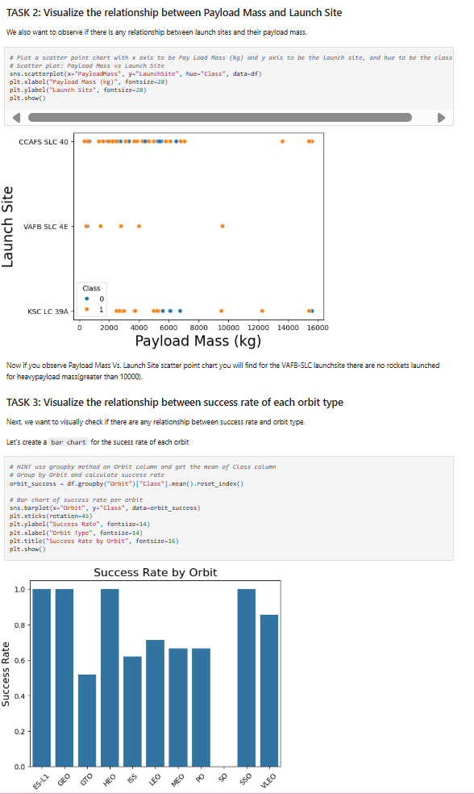
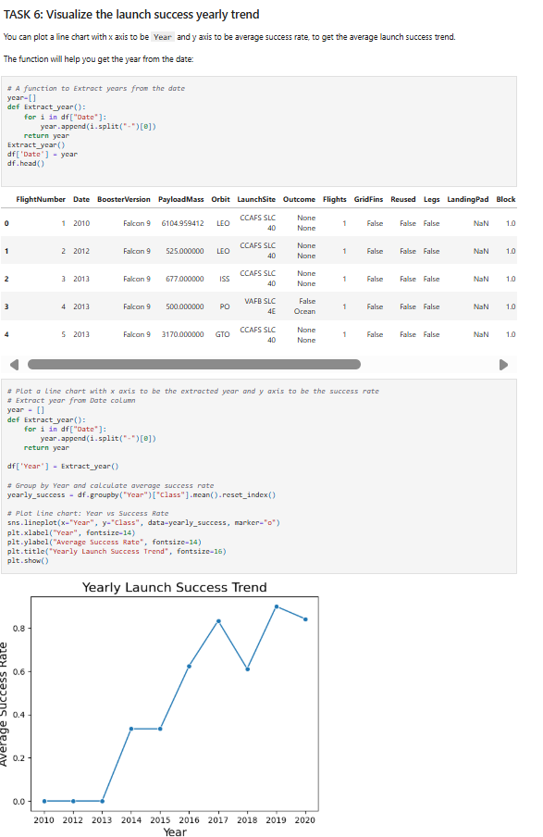
EDA with Data Visualization
I used scatter plots to explore relationships between flight number, payload mass, launch site, and orbit type—highlighting trends in launch success. Bar charts were used to compare success rates across orbit types. A line chart visualized yearly launch success trends, revealing performance improvements over time. These visualizations helped identify patterns in payload distribution, site efficiency, and mission outcomes
GitHub URL EDA with data visualization notebook
Applied-Data-Science-Capstone/edadataviz.ipynb at main · divp112005-coder/Applied-Data-Science-Capstone

Slide 13
EDA with SQL
SQL Queries Performed
- Task 1: Retrieved unique launch site names using DISTINCT.
- Task 2: Filtered 5 launch records starting with 'CCA' using LIKE and LIMIT.
- Task 3: Calculated total payload mass for NASA (CRS) missions using SUM.
- Task 4: Computed average payload mass for booster version F9 v1.1 using AVG.
- Task 5: Identified the earliest successful ground pad landing using MIN.
- Task 6: Listed boosters with successful drone ship landings and payloads between 4000–6000 kg.
- Task 7: Counted successful and failed mission outcomes using GROUP BY.
- Task 8: Found booster versions that carried the maximum payload using a subquery with MAX.
- Task 9: Extracted month-wise failure records for drone ship landings in 2015 using substr().
- Task 10: Ranked landing outcomes between specific dates using COUNT and ORDER BY.
GitHub URL of EDA with SQL notebook
Applied-Data-Science-Capstone/jupyter-labs-eda-sql-coursera_sqllite.ipynb at main · divp112005-coder/Applied-Data-Science-Capstone

Slide 14
Build an Interactive Map with Folium
I created an interactive map using Folium to explore geographical patterns in SpaceX launch success. 🔹 Task 1: Plotted all launch sites using marker objects, each labeled with site name and coordinates. 🔹 Task 2: Added color-coded circle markers for each launch, indicating success (green) or failure (red), allowing visual comparison across sites. 🔹 Task 3: Calculated distances from each launch site to nearby facilities (e.g., coastlines, cities) using geopy.distance, and visualized them with lines to show proximity.
These map objects helped reveal spatial trends—such as higher success rates at coastal sites and payload clustering—supporting deeper analysis of launch site optimization.
GitHub URL of interactive map with Folium map
Applied-Data-Science-Capstone/lab_jupyter_launch_site_location.ipynb at main · divp112005-coder/Applied-Data-Science-Capstone

Slide 15
Build a Dashboard with Plotly Dash
I built an interactive dashboard using Plotly Dash to visualize SpaceX launch performance. 🔹 Added a dropdown menu to filter data by launch site, enabling site-specific analysis. 🔹 Included a pie chart to show success vs. failure rates per site, helping users compare performance. 🔹 Integrated a scatter plot of payload mass vs. launch outcome, color-coded by booster version, to explore payload impact on success. 🔹 Added a payload range slider to dynamically filter launches by mass, revealing trends across different payload categories.
These interactions allow users to explore launch outcomes across sites, payloads, and booster types—making the dashboard both informative and user-driven.
GitHub URL of Plotly Dash lab
Applied-Data-Science-Capstone/spacex-dash-app.py at main · divp112005-coder/Applied-Data-Science-Capstone

Slide 16
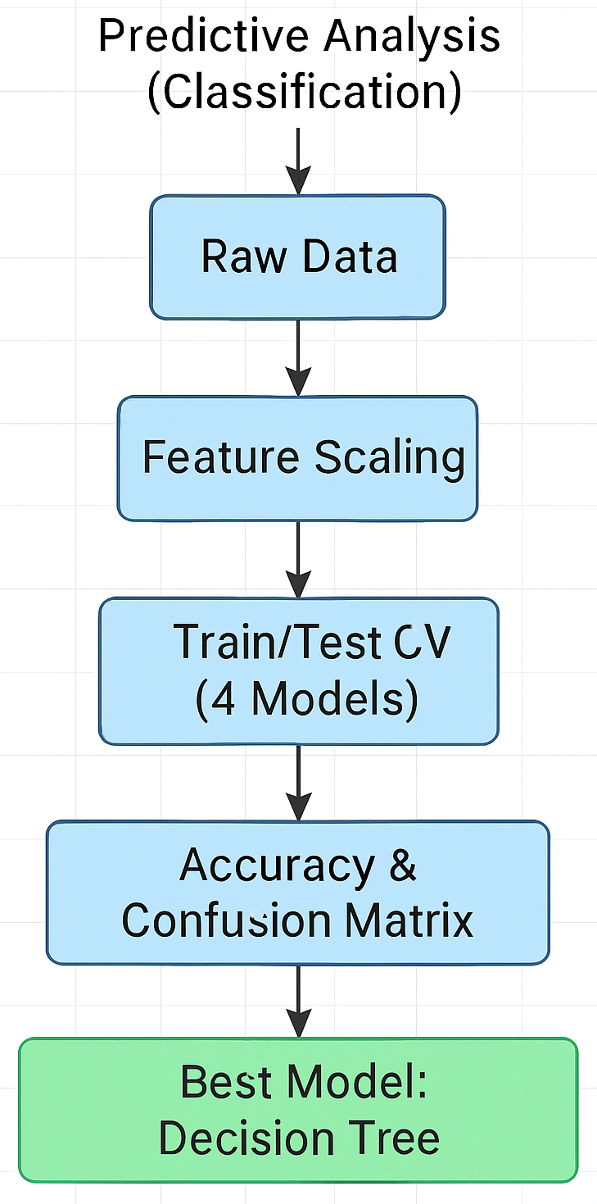
Predictive Analysis (Classification)
I built and evaluated four classification models—Logistic Regression, Support Vector Machine, Decision Tree, and K-Nearest Neighbors—to predict Falcon 9 landing success. 🔹 Standardized features and split data using train_test_split 🔹 Tuned hyperparameters with GridSearchCV (cv=10) for each model 🔹 Evaluated performance using accuracy score and confusion matrix 🔹 Compared models and found Decision Tree performed best with 87.3% validation accuracy 🔹 Best parameters: criterion='gini', max_depth=6, min_samples_leaf=2, splitter='random'
GitHub URL of predictive analysis lab
Applied-Data-Science-Capstone/SpaceX_Machine Learning Prediction_Part_5.ipynb at main · divp112005-coder/Applied-Data-Science-Capstone

Slide 17
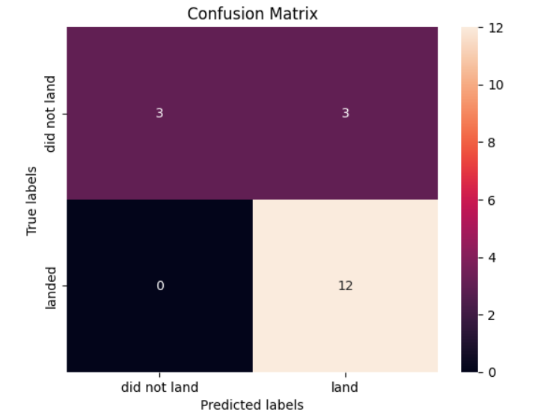
Results
Exploratory Data Analysis (EDA) revealed key patterns in launch success across orbit types, payload mass, and launch sites. Visualizations using Seaborn and Matplotlib highlighted trends such as higher success rates in LEO and payload clustering in GTO.
Interactive Analytics using Folium and Plotly Dash enabled dynamic exploration of launch site geography, success rates, and payload outcomes. Users could filter by site, payload range, and booster version to uncover spatial and performance insights.
Predictive Analysis with classification models (Logistic Regression, SVM, Decision Tree, KNN) achieved strong accuracy. After hyperparameter tuning and evaluation, the Decision Tree model emerged as the best performer with 87.3% validation accuracy, helping predict Falcon 9 landing success.

Slide 18
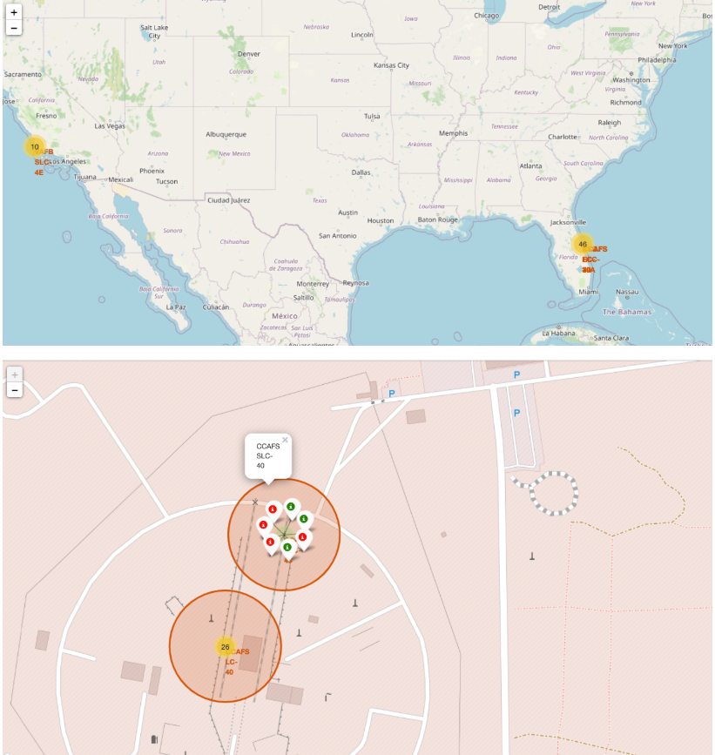
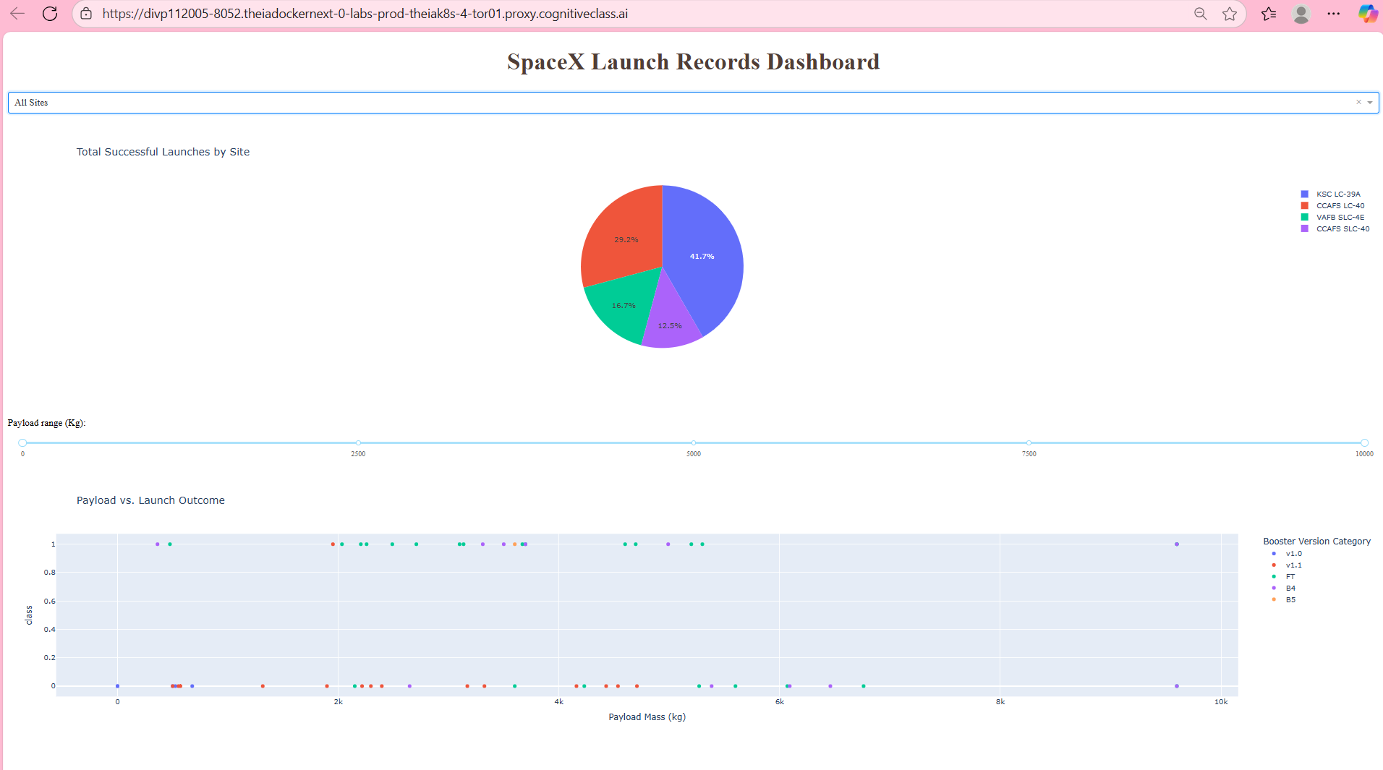
Interactive Folium map showing launch site locations and mission outcomes
Plotly Dash dashboard with dynamic filters for launch site, payload mass, and booster version

Slide 19

Section 2

Slide 20
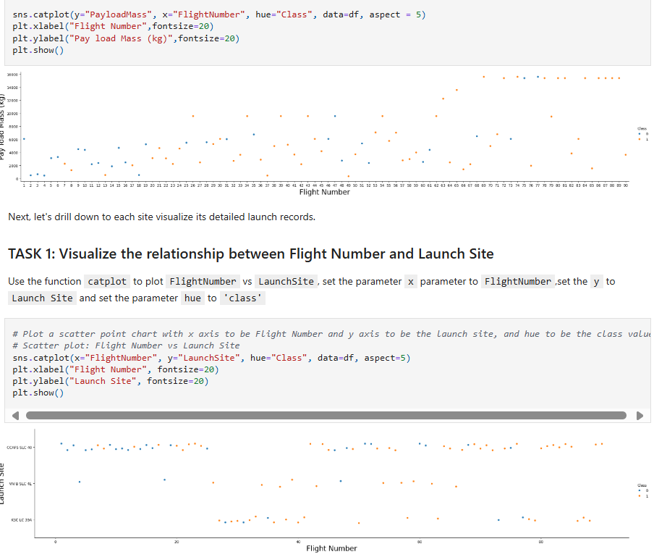
Flight Number vs. Launch Site
Show a scatter plot of Flight Number vs. Launch Site
X-axis: FlightNumber – represents the chronological order of launches
Y-axis: LaunchSite – shows the different SpaceX launch sites
Hue (Color): Class – indicates whether the launch was successful (1) or not (0)
Tool Used: Seaborn catplot() with aspect=5 for a wide layout
Insights from the Plot
You can visually track how each launch site performed over time
Sites like KSC LC-39A and CCAFS LC-40 show increasing success rates with higher flight numbers
The color-coded points make it easy to spot patterns in launch outcomes across site

Slide 21
Payload vs. Launch Site
This plot visualizes the relationship between payload mass and launch site, with each point color-coded by launch outcome class (0 = failure, 1 = success)
X-axis: Payload Mass (kg) – shows the weight of the payload for each launch
Y-axis: Launch Site – includes sites like CCAFS SLC 40, VAFB SLC 4E, and KSC LC 39A
Hue (Color): Class – orange for successful launches, blue for failures
Tool Used: Seaborn scatterplot() with hue='class' for outcome distinction
Insights
KSC LC-39A and CCAFS SLC 40 handled a wide range of payloads, including heavier missions
VAFB SLC 4E shows fewer launches with payloads mostly under 10,000 kg
Success rates appear higher for mid-to-heavy payloads at coastal sites

Slide 22
Success Rate vs. Orbit Type
X-axis: Orbit types (e.g., GTO, LEO, GEO, SSO, ES-L1)
Y-axis: Success rate (ranging from 0 to 1.0)
Tool Used: Seaborn barplot() after grouping by orbit and calculating mean of Class (success indicator)
Insights
Orbits like ES-L1, GEO, and SSO show near-perfect success rates
GTO has the lowest success rate, suggesting higher mission risk or complexity
Mid-range orbits like LEO and PO show moderate reliability
This analysis helps inform future launch planning and orbit selection strategies

Slide 23
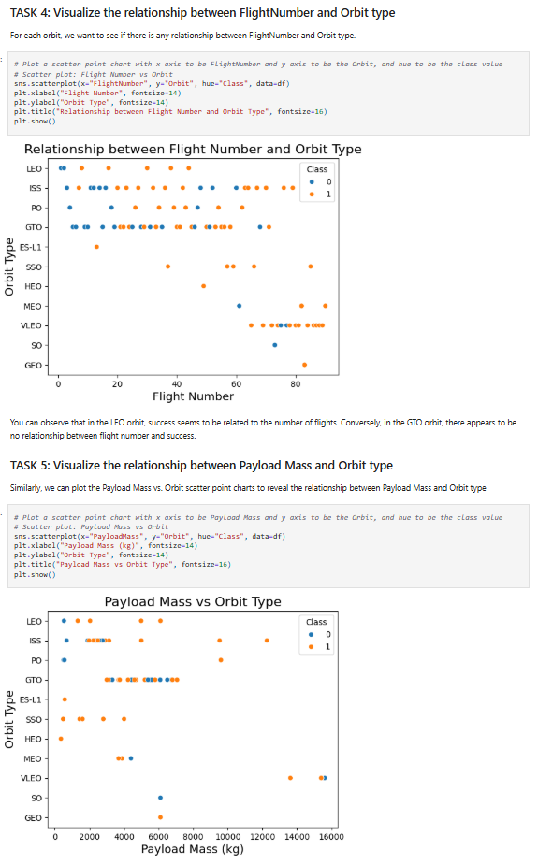
Flight Number vs. Orbit Type
X-axis: FlightNumber – chronological order of launches
Y-axis: Orbit – includes LEO, GTO, GEO, SSO, ES-L1, etc.
Hue (Color): Class – success (1) or failure (0)
Tool Used: Seaborn scatterplot() with hue='Class’
Insights
LEO orbit shows increasing success with higher flight numbers, suggesting learning curve or improved technology
GTO orbit has mixed outcomes across all flight numbers, indicating mission complexity
Helps identify which orbits are more reliable over time

Slide 24
Payload vs. Orbit Type
X-axis: PayloadMass – weight of payload in kilograms
Y-axis: Orbit – same orbit types as above
Hue (Color): Class – success (1) or failure (0)
Tool Used: Seaborn scatterplot() with hue='Class’
Insights
Heavier payloads are typically sent to GTO and GEO orbits
Lighter payloads dominate LEO and SSO missions
Success rates vary by orbit and payload mass, useful for mission planning

Slide 25
Launch Success Yearly Trend
X-axis: Year – from 2010 to 2020
Y-axis: Average Success Rate – calculated as the mean of the Class column (1 = success, 0 = failure)
Tool Used: Matplotlib line plot after grouping by year
Insights
From 2010 to 2013, the success rate remained at 0.0, reflecting early-stage development
A steady rise begins in 2014, reaching ~0.4 and climbing to 0.8 by 2017
A slight dip in 2018 suggests a temporary setback, followed by a peak near 0.9 in 2019
2020 shows a small decline but maintains a high success rate (~0.85), indicating overall maturity

Slide 26

All Launch Site Names
This query extracts all unique launch site names from the SpaceX dataset using the DISTINCT clause. These four sites represent the primary operational bases for Falcon 9 missions. Identifying them is a foundational step for analyzing site-specific performance, success rates, and payload trends in later visualizations and predictive models.

Slide 27

Launch Site Names Begin with 'CCA'
This query filters launch records where the site name starts with 'CCA', capturing missions from Cape Canaveral Air Force Station (CCAFS). These early Falcon 9 launches show:
Consistent use of LEO orbit
Gradual increase in payload mass
Mostly successful missions, though early landings were either unsuccessful or not attempted
This subset is useful for analyzing SpaceX’s early launch performance and site-specific trends.

Slide 28

Total Payload Mass
This query calculates the total payload mass delivered by SpaceX boosters for NASA’s Commercial Resupply Services (CRS) missions. Using the SUM() function on the PayloadMassKG column and filtering by Customer = 'NASA (CRS)', we find that these missions collectively transported 45,996 kilograms of cargo—highlighting SpaceX’s critical role in supporting ISS logistics

Slide 29

Average Payload Mass by F9 v1.1
This query calculates the average payload mass delivered by the F9 v1.1 booster version using the AVG() function. The result—2,928.4 kilograms—reflects the typical cargo capacity for missions using this early Falcon 9 variant. It’s a useful benchmark for comparing performance across booster generations.

Slide 30

First Successful Ground Landing Date
This query uses the MIN() function to identify the earliest date when a SpaceX booster successfully landed on a ground pad. The result—December 22, 2015—marks a historic milestone in reusable rocket technology, showcasing SpaceX’s breakthrough in precision landing.

Slide 31

Successful Drone Ship Landing with Payload between 4000 and 6000
This query filters for boosters that:
Landed successfully on a drone ship
Carried a payload mass between 4000 and 6000 kg
The result highlights Falcon 9 Full Thrust (FT) variants that consistently performed well under mid-weight payload conditions. These boosters demonstrate SpaceX’s precision in balancing payload delivery with reusable landing technology.

Slide 32

Total Number of Successful and Failure Mission Outcomes
These queries count the number of successful and failed mission outcomes using the COUNT() function and filtering with LIKE 'Success%' and LIKE 'Failure%'. The results show that SpaceX achieved a high success rate, with 100 successful launches compared to 16 failures, reflecting strong reliability and continuous improvement in launch operations.

Slide 33

Boosters Carried Maximum Payload
This query identifies all booster versions that achieved the maximum recorded payload mass using a subquery with MAX(PayloadMassKG). The result highlights the Falcon 9 Block 5 series as SpaceX’s most capable boosters in terms of payload delivery—key players in high-capacity missions.

Slide 34

2015 Launch Records
This query filters for failed drone ship landings that occurred in 2015, revealing two missions using Falcon 9 v1.1 boosters launched from Cape Canaveral (CCAFS LC-40). These early attempts reflect SpaceX’s experimental phase in perfecting autonomous sea landings—a critical step toward reusability.

Slide 35

Rank Landing Outcomes Between 2010-06-04 and 2017-03-20
This query ranks all landing outcomes from SpaceX missions between June 2010 and March 2017, using GROUP BY and ORDER BY COUNT DESC. The results show:
Most missions during this period had no landing attempt, reflecting early development stages
Drone ship landings were more frequent than ground pad landings
A few outcomes like parachute failure and uncontrolled ocean landings highlight experimental phases
This ranking helps visualize SpaceX’s evolving landing strategy and success trajectory.

Slide 36

Section 3

Slide 37

Folium Map Screenshot 1
This Folium map shows the locations of SpaceX’s primary launch sites in the U.S.—KSC LC-39A and CCAFS SLC-40 in Florida, and VAFB SLC-4E in California. Their coastal placement supports safe launch trajectories and access to diverse orbital paths, with Florida sites favoring equatorial missions and California supporting polar orbits.
Geographic Distribution of SpaceX Launch Sites

Slide 38

Folium Map Screenshot 2
This visual compares launch outcomes at SpaceX’s major sites using color-coded markers: 🟢 Green = Successful launches 🔴 Red = Failed launches
Florida hosts three launch pads—KSC LC-39A, CCAFS LC-40, and CCAFS SLC-40—with a higher volume of launches and a strong trend toward success. California’s VAFB SLC-4E supports fewer missions but shows a similar mix of outcomes. The circular marker layout helps visualize reliability and frequency at each site, highlighting Florida’s strategic dominance in SpaceX’s operational history.
Launch Outcome Comparison Across SpaceX Sites

Slide 39

Folium Map Screenshot 3
This map shows the selected launch site's distance to nearby features like railway stations, highways, coastlines, and cities. Launch sites are close to coastlines but maintain safe distance from urban areas and major transport hubs.
Launch Site Proximity to Infrastructure

Slide 40

Section 4

Slide 41
Dashboard Screenshot 1
Successful Launches by Site – Pie Chart Overview
This dashboard visualizes the distribution of successful SpaceX launches across four major sites.
KSC LC-39A leads with 42.9% of total successes
Followed by CCAFS SLC-40 at 32.7%
VAFB SLC-4E contributes 18.4%
CCAFS LC-40 accounts for 6.0%
The pie chart highlights Florida’s dominance in launch activity, with Kennedy Space Center playing a central role in SpaceX’s success record.

Slide 42

Dashboard Screenshot 2
This donut chart displays the launch success ratio for Kennedy Space Center LC-39A, the site with the highest success rate among SpaceX launch sites.
🟦 76.9% Success (blue segment)
🟥 23.1% Failure (red segment)
Insight: KSC LC-39A demonstrates strong reliability, with nearly 4 out of every 5 launches resulting in success. This high success rate reinforces its role as SpaceX’s flagship launch pad for major missions.
Launch Success Ratio – KSC LC-39A

Slide 43
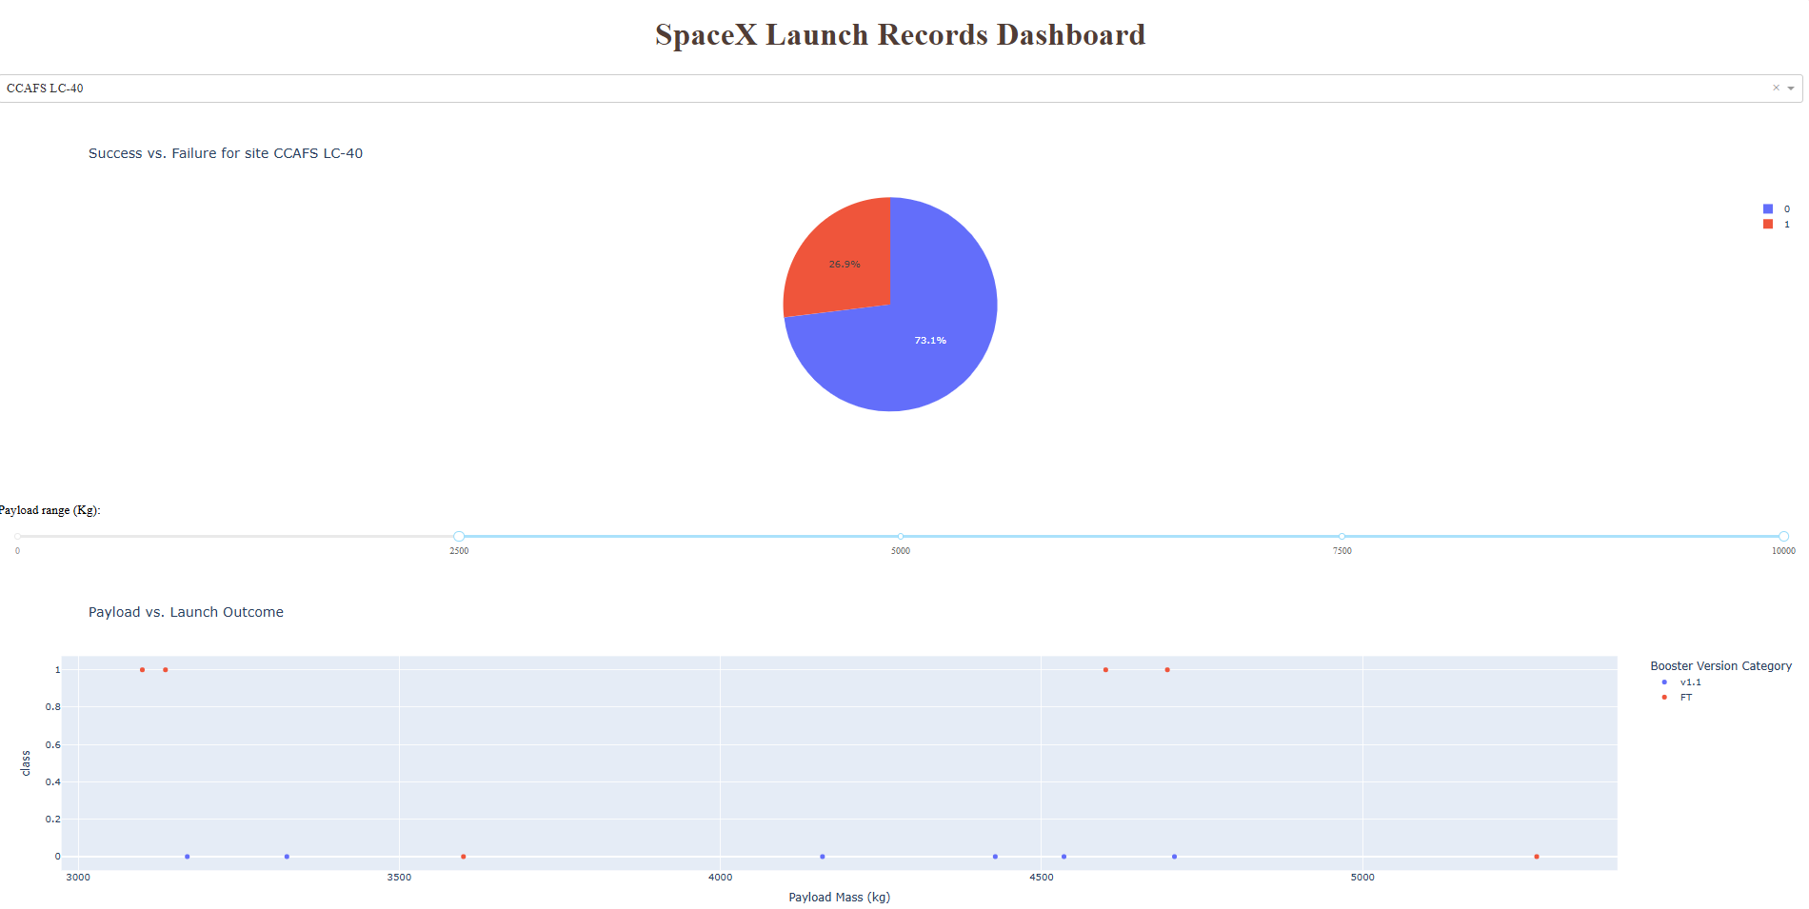
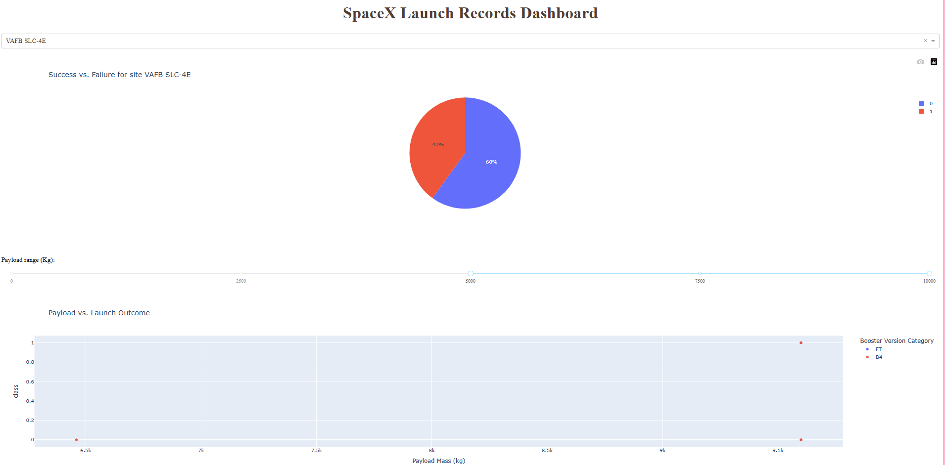
Dashboard Screenshot 3

Slide 44

Section 5

Slide 45

Classification Accuracy
This code compares four classification models—K-Nearest Neighbors, Decision Tree, Logistic Regression, and Support Vector Machine—using cross-validation scores. The Decision Tree model achieved the highest accuracy of 87.32%, with the following best parameters:
criterion: gini
max_depth: 6
max_features: auto
min_samples_leaf: 1
min_samples_split: 5
splitter: random
Insight: Decision Tree outperformed other models, making it the most reliable choice for this classification task.
Best Classification Model Based on Accuracy

Slide 46

Confusion Matrix
This confusion matrix visualizes the performance of the Decision Tree classifier, which achieved the highest accuracy (87.32%) among all models.
Insight:
✅ The model correctly predicted 12 successful landings and 3 non-landings
❌ It misclassified 3 non-landings as landings
🔍 No false negatives — meaning every actual landing was correctly identified
This matrix highlights the model’s strength in identifying successful landings, with a slight tendency to overpredict landings. Overall, it reflects strong classification performance.
Confusion Matrix – Decision Tree Model

Slide 47
Conclusions
🚀 SpaceX launch success is highest at KSC LC-39A, with a 76.9% success rate
📊 Decision Tree emerged as the best classification model with 87.32% accuracy
📍 Launch sites are strategically located near coastlines, away from cities and major transport hubs
📈 FT boosters show highest reliability, especially in the 4000–8000 kg payload range
🧠 Confusion matrix confirms strong model performance with zero false negatives

Slide 48
Appendix
Key supporting materials used throughout the project:
🐍 Python Code Snippets
Model selection and hyperparameter tuning
Confusion matrix generation
Folium map creation and proximity analysis
🧠 SQL Queries
Booster performance and payload analysis
Landing outcome filtering and ranking
📊 Charts & Visuals
Pie charts for launch success by site
Donut chart for KSC LC-39A success ratio
Scatter plot: Payload vs. Launch Outcome
Confusion matrix heatmap
📓 Notebook Outputs
Classification accuracy scores
Best model parameters
Launch site proximity screenshots
📁 Datasets & Filtered Results
SpaceX launch records
Payload mass ranges
Booster version categories

Slide 49


